Slide 1

KJ’S EDUCATIONAL INSTITUTES TRINITY COLLEGE OF ENGINEERING AND RESEARCH PUNE Department of Information Technology AY 2025-26 SEM-I BE Project Stage –I A Presentation On Penetration Testing For Websites using LLM
By
PR 2025-26-01
Soham Deshmukh (IT-4012)
Mohanish Kulkarni (IT-4032)
Jayam Mehta (IT-4037)
Pallavi Akolkar (IT-4002)
Under the Guidance of
Dr. Vilas Gaikwad

Slide 2
Outline
Introduction
Problem Statement
Motivation & Objectives
Scope of the project
Literature Survey
GAP Analysis
Platform of Implementation (Software / Hardware Requirements)
Architecture of Proposed Work
Details of Schedule of Project Stage-I Work
Conclusion
References

Slide 3
Introduction
Traditional penetration testing is manual, time-consuming, and inconsistent.
Automated AI systems can enhance vulnerability detection.
Integration with ethical hacking tools improves testing accuracy and consistency.
AI-powered scanners analyze code, endpoints, and configurations for potential exploits.
Intelligent automation helps detect logic flaws and hidden security weaknesses.
Real-time vulnerability mapping ensures better coverage and faster remediation.
Automated testing can adapt dynamically to different application architectures.

Slide 4
Problem Statement
Existing penetration testing tools require significant manual effort and lack intelligent reasoning.
Automated scanners often produce high false positives and miss business-logic vulnerabilities.
There is a need for a context-aware, intelligent system that integrates AI reasoning into security testing.

Slide 5
Motivation & Objectives
Motivation: Current tools cannot keep up with the scale and complexity of modern web applications.
Objectives:
Automate reconnaissance and information gathering using intelligent crawlers and LLM-based analysis for
subdomains, endpoints, and tech-stack discovery.
Combine LLMs with conventional scanners to detect vulnerabilities and reduce false positives.
Perform dynamic attack simulation using adaptive, AI-driven testing to generate custom payloads for
authorized validation.
Generate real-time, human-readable reports that explain vulnerabilities, impacts, and step-by-step remediation.
Build ethical, secure framework controls with strict authorization, access control, and comprehensive
logging for auditable testing.

Slide 6
Scope of the project
Incorporation of contextual threat modeling to simulate real-world attack strategies.
Use of AI-driven adaptive learning to stay updated with emerging exploits and attack vectors.
Development of a centralized dashboard for real-time monitoring and analytics.
Support for multilingual web applications and international security compliance standards.
Enhanced explainability and visualization of attack paths for better understanding by developers.
LLM to enhance contextual understanding and automate vulnerability explanation.
Automated prioritization of vulnerabilities based on business impact and exploit likelihood.

Slide 7
Literature Survey
Paper / Tool | Approach / Technique | Strengths | Limitations
AI-Assisted Penetration Testing Using LLMs (Mehta et al., 2025) | Integrating LLMs with traditional scanners for contextual vulnerability analysis | Improves detection of logical and context-based flaws | Requires powerful compute resources; risk of AI hallucination
Automated Vulnerability Assessment using NLP & DL (Verma & Srivastava, 2024) | NLP models for vulnerability classification and mapping to VEs | Reduces manual effort; faster vulnerability categorization | Limited reasoning; not adaptive for new exploit patterns
LLM-Driven Web Security Framework (Iqbal et al., 2025) | GPT-based reasoning for fuzzing and exploit prediction | Increases coverage for OWASP Top 10 vulnerabilities | High API dependency; limited scalability
Intelligent Automation in Ethical Hacking (Banerjee & Thomas, 2023) | Generative AI for reconnaissance and payload generation | Automates repetitive tasks; maintains ethical compliance | Needs expert supervision for accurate validation
AI-Powered Security Testing & Remediation (Rao et al., 2024) | AI model for prioritizing and remediating vulnerabilities | Generates actionable remediation steps automatically | Focused mainly on risk ranking, not exploit verification

Slide 8
Literature Survey
Paper / Tool | Approach / Technique | Strengths | Limitations
Automated Pentest Pipeline using Reinforcement Learning (Bhattacharya et al., 2025) | RL framework for adaptive vulnerability scanning | Learns and improves with testing iterations | Complex implementation; training overhead
AI-Oriented Web Security Testing (Lee et al., 2024) | Deep learning for context-aware vulnerability mapping | Enhances precision in identifying linked flaws | Requires large, labeled datasets
Generative AI for Cyber Defense & Penetesting (Ahmed & Zaman, 2025) | Generative AI for attack surface mapping and simulation | Effective in multi-stage attack generation | Not suitable for real-time or production testing
AI-Based Pentest Automation using Knowledge Graphs & LLMs (Nair et al., 2025) | Combines knowledge graphs with LLM reasoning | Correlates vulnerabilities and exploits intelligently | Prototype stage; limited industrial testing
Prompt-Driven Pentesting Framework (Chen et al., 2025) | Prompt engineering for LLM-guided test generation | Flexible and customizable testing approach | Requires prompt tuning; risk of irrelevant outputs

Slide 9
GAP Analysis
AI-based models exist but rarely integrate with complete penetration testing workflows.
No unified system currently merges automation, reasoning, and secure orchestration.
Existing scanners often generate false positives and require manual validation.
Current frameworks fail to adapt to evolving attack patterns and business logic vulnerabilities.
Lack of feedback and continuous learning mechanisms limits improvement in detection accuracy.

Slide 10
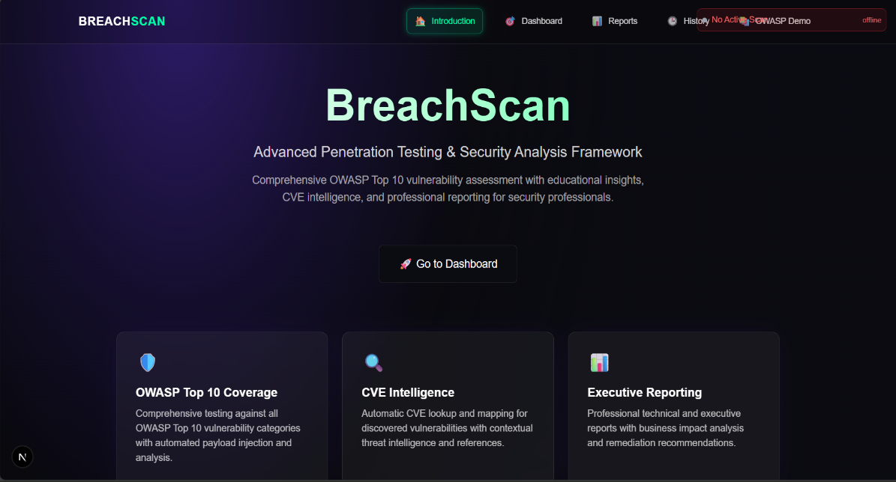
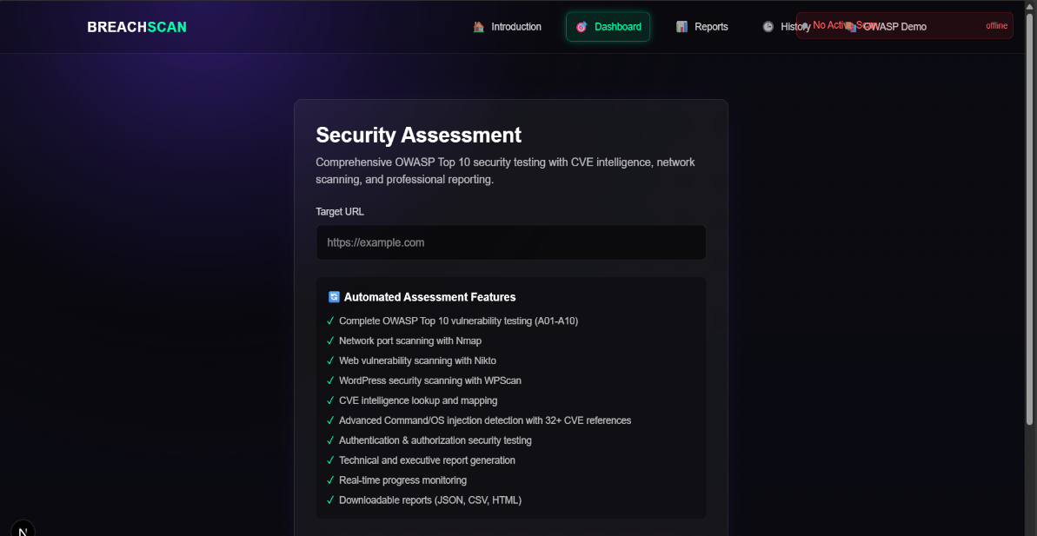
Platform of Implementation
Hardware:
20+ core CPU
64GB RAM
1 to 2 TB SSD storage
Stable internet connection
Software:
Operating System: Kali Linux / Ubuntu / Windows
Backend: Python
Frontend: ReactJS, CSS , Tailwind
Tools: Nmap, Docker
LLM APIs: GPT-4o / Claude 3 for reasoning and reporting

Slide 11
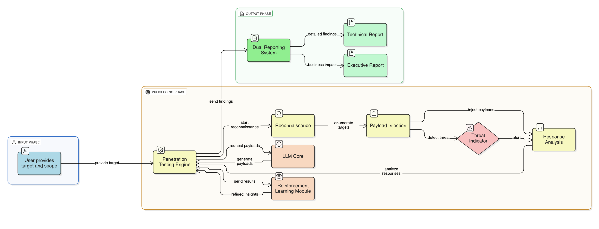
Architecture of Proposed Work

Slide 12
Details of Schedule of Project Stage-I Work
Week No. | Activity Planned
Week 01 | Finalization of Project Domain, Submission of 4–5 Proposed Topics, and Literature Survey (minimum 2–3 papers per topic).
Week 02 | Identification of Problem Statement/Title based on literature review, feasibility analysis, and gap identification. Pre-Review Presentation and Topic Finalization.
Week 03 | Documentation of Motivation, Objectives, and Defined Scope of the Finalized Project.
Week 04 | Comparative Study of Existing Methods/Tools, Feasibility Assessment, and Listing of Required Resources (tools, technologies, hardware/software).
Week 05 | Overview of Proposed System, Expected Output, and Basic Design. Project Review – 1.
Week 06 | System Architecture and Initial Design Elements (UML, Context-level DFD, High-Level Block Diagrams).
Week 07 | Documentation of System Requirements – Functional and Non-Functional.
Week 08 | Preparation of the SRS (Software Requirements Specification) Document as per the finalized problem statement.
Week 09 | Requirement Analysis using UML/ER Diagrams, Use Case Diagrams, Class/Activity Diagrams. Project Review – 2.
Week 10 | Detailed System Architecture, Design Specifications, and Algorithmic Analysis.
Week 11 | Module-level Testing Plan and Initial Test Case Design.
Week 12 | Detailed Design – Expanded DFD Levels, Module Specifications, and Data Dictionary.
Week 13 | Development of Initial Working Modules (at least 3–4). Submit partial coding with documentation. Continue survey paper preparation.
Week 14 | Drafting of Research Paper, Finalization of Project Report Format, Timeline Planning. Project Review – 3.

Slide 13
Conclusion
The project introduces an LLM-augmented penetration testing framework for web applications.
It automates complex security analysis while maintaining ethical oversight.
The system shows improved vulnerability coverage and reduced manual effort.
LLM integration enhances accuracy, reporting quality, and scalability for future
cybersecurity solutions.

Slide 14
References
R. Mehta et al., AI-Assisted Penetration Testing Using LLMs, IEEE CISS, 2025.
A. Verma et al., Automated Vulnerability Assessment Using NLP, ACM ISR, 2024.
M. Iqbal et al., LLM-Driven Web Security Framework, Springer J. Cybersecurity, 2025.
J. Banerjee et al., Intelligent Automation in Ethical Hacking Using Generative AI, Elsevier, 2023.
K. Rao et al., AI-Powered Security Testing and Remediation System, IEEE Access, 2024.
D. Bhattacharya et al., Automated Penetration Testing Pipeline Using Reinforcement Learning,
IEEE ICECT, 2025.
H. Lee et al., AI-Oriented Web Security Testing with Deep Context Understanding,
Elsevier – Computers & Security, 2024.

Slide 15
References
P. Nair et al., AI-Based Pentest Automation through Knowledge Graphs and LLMs, IEEE CIIS, 2025.
N. Bhatia et al., LLM-Augmented Security Operations for Web Applications, Elsevier Journal
of Information Assurance and Security, 2024.
Y. Chen et al., Prompt-Driven Penetration Testing Framework Using Generative AI, IEEE ICICS, 2025.
F. Ahmed and L. Zaman, Generative AI for Automated Cyber Defense and Penetration Testing,
IEEE AICR, 2025.
R. Tiwari et al., Natural Language Processing for Security Log Analysis and Threat Detection,
ACM Transactions on Cyber Intelligence, 2024.
M. Pathak et al., Smart Vulnerability Management Using ChatGPT-Based Analysis,
Springer International Journal of Intelligent Security Systems, 2025.

Slide 16
Thank you!!!
Questions???

